Slide 1
Processes
Abhijit A M
abhijit.comp@coep.ac.in

Slide 2
Process related data structures in kernel code
Kernel needs to maintain following types of data structures for managing processes
  List of all processes
  Memory management details for each, files opened by each etc.
  Scheduling information about the process
  Status of the process
  List of processes “waiting” for different events to occur,
  Etc.

Slide 3
Process Control Block
  A record representing a process in operating system’s data structures
  OS maintains a “list”of PCBs, one for each process
  Called “struct task_struct” in Linux kernel code and “struct proc” in xv6 code

Slide 4
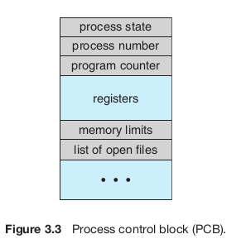
Fields in PCB
  Process ID (PID)
  Process State
  Program counter
  Registers (copy)
  Memory limits of the process
  Accounting information
  I/O status
  Scheduling information
  array of file descriptors (list of open files)
  ...etc

Slide 5
List of open files
Program did
rfd = open(“/etc/passwd”, O_RDONLY)
fd [ ]
struct file
0
1
2
3
4
Info about
Standard
Input file
File pos, etc
struct file
Info about
Standard
output file
File pos, etc
struct file
struct file
Info
About
/etc/passwd
file
File pos, etc
Info about
Standard
Error file
File pos, etc
PCB

Slide 6
List of open files
The PCB contains an array of pointers, called file descriptor array (fd[ ]), pointers to structures representing files
When open() system call is made
  A new file structure is created and relevant information is stored in it
  Smallest available of fd [ ] pointers is made to point to this new struct file
  The index of this fd [ ] pointer is returned by open
When subsequent calls are made to read(fd, ....) or write(fd, ...) , etc.
  The kernel gets the “fd” as an index in the fd[ ] array and is able to locate the file structure for that file

Slide 7
// XV6 Code : Per-process state
enum procstate { UNUSED, EMBRYO, SLEEPING, RUNNABLE, RUNNING, ZOMBIE };
struct proc {
uint sz; // Size of process memory (bytes)
pde_t* pgdir; // Page table
char *kstack; // Bottom of kernel stack for this process
enum procstate state; // Process state
int pid; // Process ID
struct proc *parent; // Parent process
struct trapframe *tf; // Trap frame for current syscall
struct context *context; // swtch() here to run process
void *chan; // If non-zero, sleeping on chan
int killed; // If non-zero, have been killed
struct file *ofile[NOFILE]; // Open files
struct inode *cwd; // Current directory
char name[16]; // Process name (debugging)
};
struct {
struct spinlock lock;
struct proc proc[NPROC];
} ptable;
struct file {
enum { FD_NONE, FD_PIPE, FD_INODE } type;
int ref; // reference count
char readable;
char writable;
struct pipe *pipe;
struct inode *ip;
uint off;
};

Slide 8
Process Queues/Lists inside OS
Different types of queues/lists can be maintained by OS for the processes
  A queue of processes which need to be scheduled
  A queue of processes which have requested input/output to a device and hence need to be put on hold/wait
  List of processes currently running on multiple CPUs
  Etc.

Slide 9
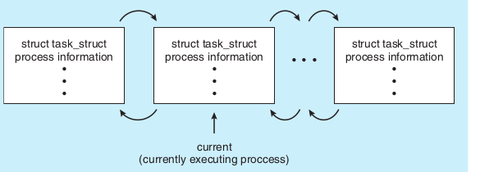
// Linux data structure
struct task_struct {
long state;/*state of the process */
struct sched_entity se; /* scheduling information */
struct task_struct *parent; /*this process’s parent */
struct list_head children; /*this process’s children */
struct files_struct *files; /* list of open files */
struct mm_struct *mm;/*address space */

Slide 10
struct list_head {
struct list_head *next, *prev;
};
n
P n

Slide 11
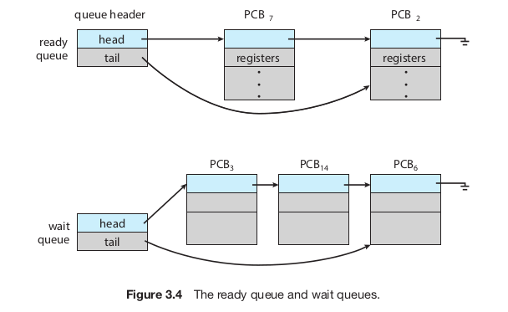

Slide 12
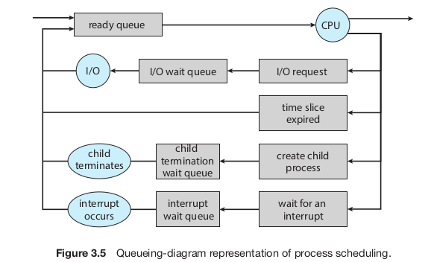

Slide 13
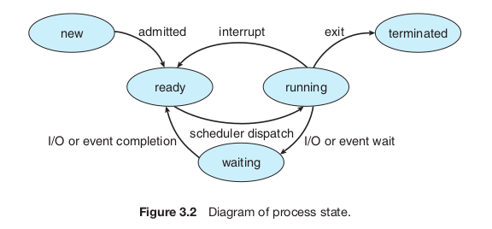
See state in output of
ps axu
(BSD style options, without -)
On Linux
Conceptual diagram

Slide 14
“Giving up” CPU by a process or blocking
OS Syscall
sys_read(int fd, char *buf, int len) {
file f = current->fdarray[fd];
int offset = f->position;
...
disk_read(... , offset, ...);
// Do what now?
//asynchronous read
//Interrupt will occur when the disk read is complete
// Move the process from ready queue to a wait queue and call scheduler!
// This is called "blocking"
Return the data read ;
}
disk_read(...., offset, .... ) {
__asm__("outb PORT ..");
return;
}
int main() {
i = j + k;
scanf("%d", &k);
}
int scanf(char *x, ...) {
...
read(0, ..., ...);
}
int read(int fd, char *buf, int len) {
...
__asm__ { "int 0x80..."}
...
}

Slide 15
“Giving up” CPU by a process or blocking
The relevant code in xv6 is in
Sleep()
The wakeup code is in wakeup() and wakeup1()
To be seen later

Slide 16
Context Switch
Context
  Execution context of a process
  CPU registers, process state, memory management information, all configurations of the CPU that are specific to execution of a process/kernel
Context Switch
  Change the context from one process/OS to OS/another process
  Need to save the old context and load new context
  Where to save? --> PCB of the process

Slide 17
Context Switch
Is an overhead
No useful work happening while doing a context switch
Time can vary from hardware to hardware
Special instructions may be available to save a set of registers in one go

Slide 18
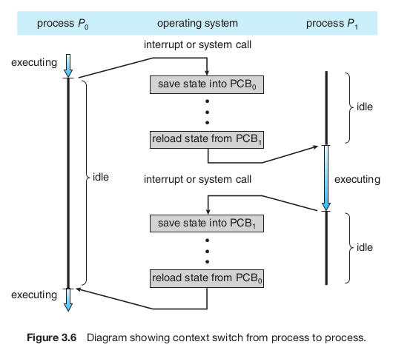

Slide 19
Pecularity of context switch
When a process is running, the function calls work in LIFO fashion
  Made possible due to calling convention (a protocol for using processor stack for passing parameters and returning values, used by compilers to generate machine code)
When an interrupt occurs
  It can occur anytime
  Context switch can happen in the middle of execution of any function
After context switch
  One process takes place of another
  This “switch” is obviously not going to happen using calling convention, as no “call” is happening
  Code for context switch must be in assembly!

Slide 20
NEXT: XV6 code overview
1. Understanding how traps are handled
2. How timer interrupt goes to scheduler
3. How scheduling takes place
4. How a “blocking” system call (e.g. read()) “blocks”

